Slide 1
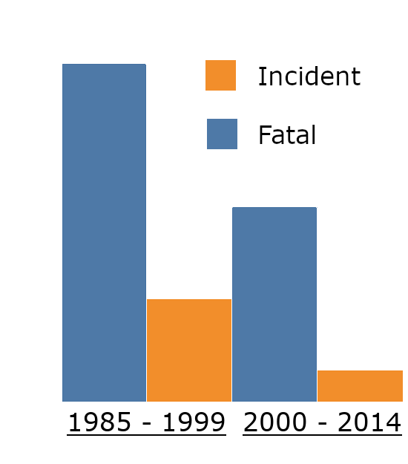
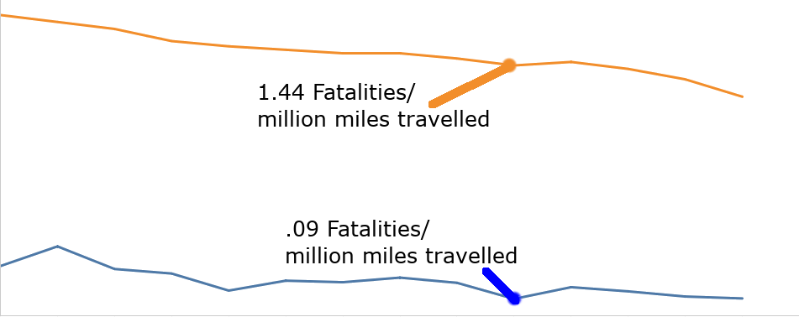
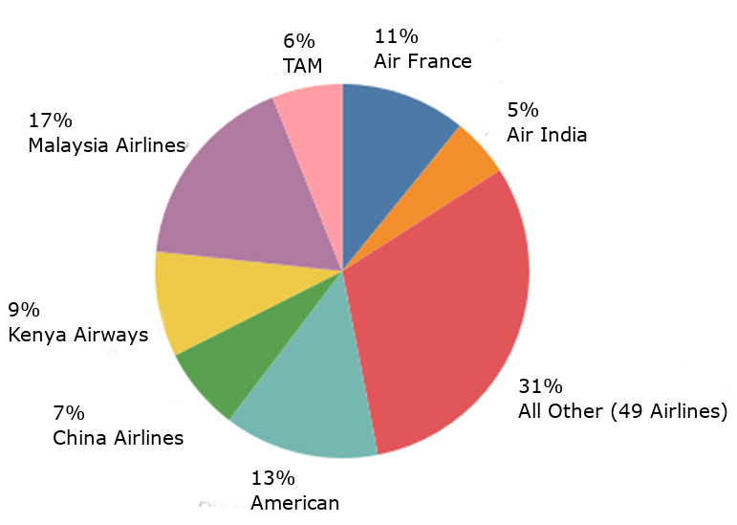
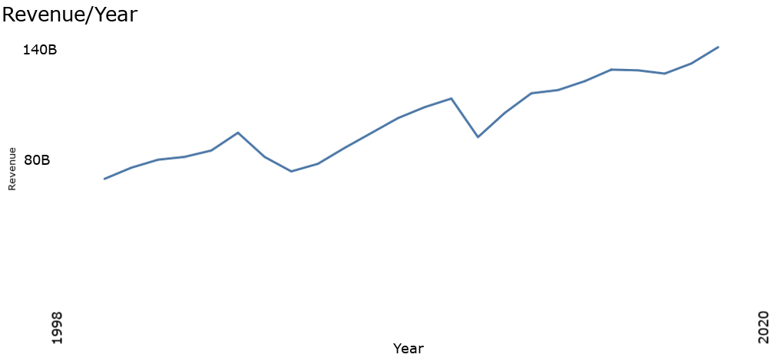
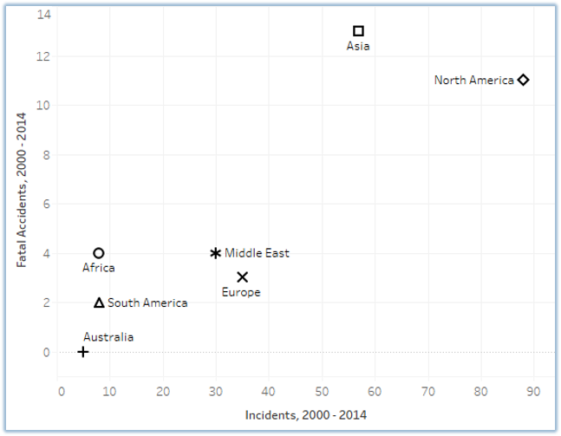
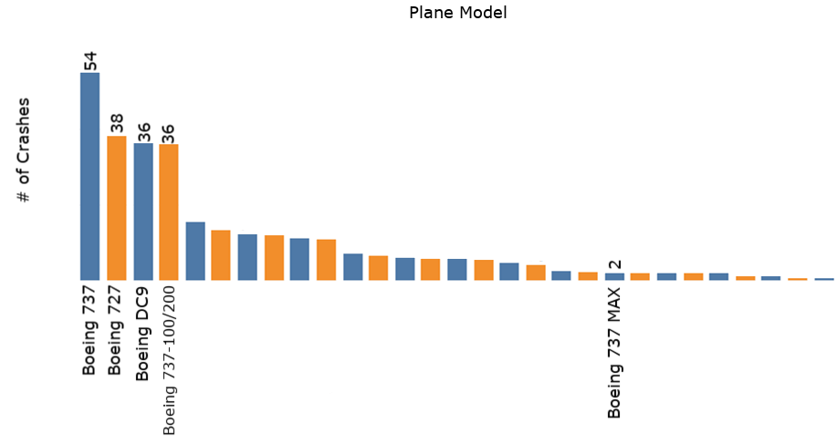
HOW SAFE IS AIR TRAVEL?
You might have heard about the Boeing 737-MAX and wondered, how safe is it to travel by airplane these days?
57%
Decline in Total Incidents
53%
Decline in fatal incidents,
proportionally
It’s safer than driving.
Car versus plane fatalities per million miles driven since 2000
Are all airlines experiencing fatalities?
From 2000 to 2014, 7 airlines were responsible for 69% of all fatal accidents.
The remaining 49 airlines saw only 31% of the fatalities! Only a small number of carriers have dubious safety records.
Are less accidents happening because less people are flying?
More flights are happening than ever!
Are different regions more prone to fatal incidents?
North American Carriers
Total Incidents: 1st
Percent Fatal: 4th
African Carriers
50%
Of incidents involved fatalities
Australian Carriers
0%
Of incidents involved fatalities.
Of course, they only had 5 incidents.
The Boeing 737 has the most, but it also has flown the most miles!
The 737 Max had 2 crashes after 650,000 flights.
Comparatively, the Boeing 737-600/700/800/900 had 11 events in 110.3 Million flights.
Sources:
Airline Safety - Airline Data Project
Transportation Data - NHTSA
Plane Incidents by Model - AirSafe.com
Plane Crashes, Global - Data.World, by way of Kaggle
Global pandemics aside, Airplane Travel remains one of the safest modes of transportation that exists!

